Slide 1
Capstone Project-Exploring Bengalore-Silicon Valley
Prepared By
Himaja Gattu

Slide 2
Introduction/Business Problem
Bengaluru — the capital city of Karnataka, India. This bustling city is known as the Silicon Valley of India. It’s also the start-up capital of India. Hundreds of people from all over the world come to Bengaluru to make their careers, to build their life. Hence this city hosts all kinds of people be it unskilled or skilled like Software professionals, Government officials, Diplomats, Administrators, Students and so on. It has a population over 12.34 million and spread across 709 square kilometres. As a resident of this city, I have decided to use Bengaluru in my project. Through this project I will explore this beautiful city so that the new comers can decide which area/neighbourhood they would want to stay in or figure out the best places to eat/shop.

Slide 3
The Data Section
I made use of a python library called pgeocode(https://github.com/symerio/pgeocode) which is a high-performance off-line querying of GPS coordinates, region name and municipality name from postal codes. Distances between postal codes as well as general distance queries are also supported. The used GeoNames database includes postal codes for 83 countries.

Slide 4
The Data Section…Contd.
I used ‘ index postal_codes’ function which creates a data frame of unique postal codes of a given country. The data frame consists of following columns:
o country code: iso country code, 2 characters
o postal code: postal code
o place name: place name (e.g. town, city etc)
o state_name: 1. order subdivision (state)
o state_code: 1. order subdivision (state)

Slide 5
The Data Section…Contd.
o county_name: 2. order subdivision (county/province)
o county_code: 2. order subdivision (county/province)
o community_name: 3. order subdivision (community)
o community_code: 3. order subdivision (community)
o latitude: estimated latitude (wgs84)
o longitude: estimated longitude (wgs84)
o accuracy: accuracy of lat/lng from 1=estimated to 6=centroid

Slide 6
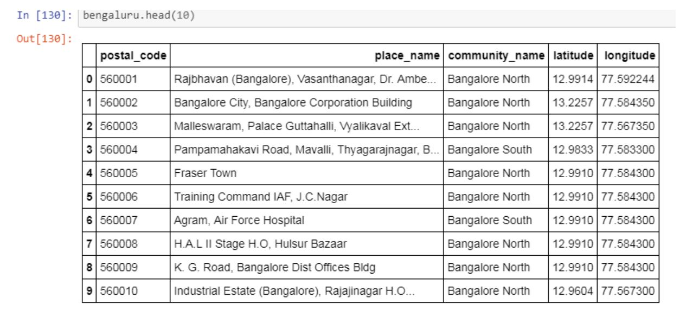
The Data Section…Contd.
Using this function, I first I obtained the postal code details for the entire country India and then queried the data to retain the postal codes of Bengaluru. The sample data is shown below:

Slide 7
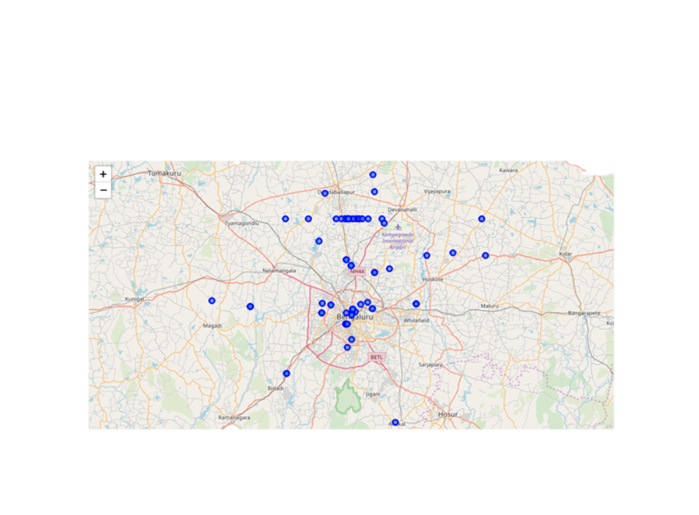
Methodology
I used Forsquare API to get the most common venues of given community of Bengaluru.
I used python folium library to visualize geographic details of Bengaluru and its places and I created a map of Bengaluru as shown below:

Slide 8
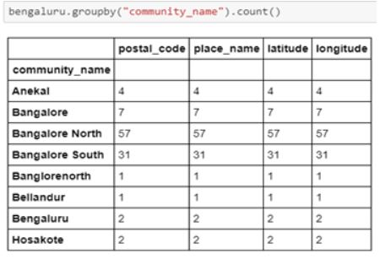
Methodology…Contd.
As Bengaluru North had highest number of places, I decided to just focus on Bengaluru North alone

Slide 9
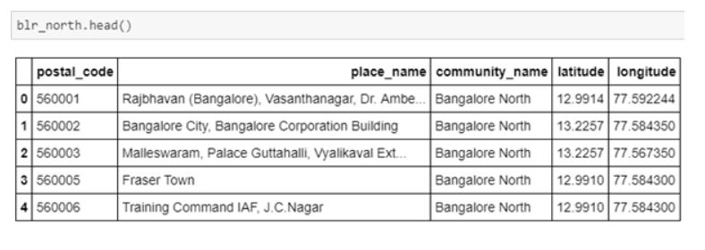
Methodology…Contd.
As Bengaluru North had highest number of places, I decided to just focus on Bengaluru North alone

Slide 10
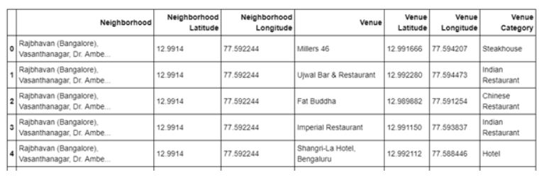
Methodology…Contd.
Retrieved all the venue details from Foursquare API.

Slide 11
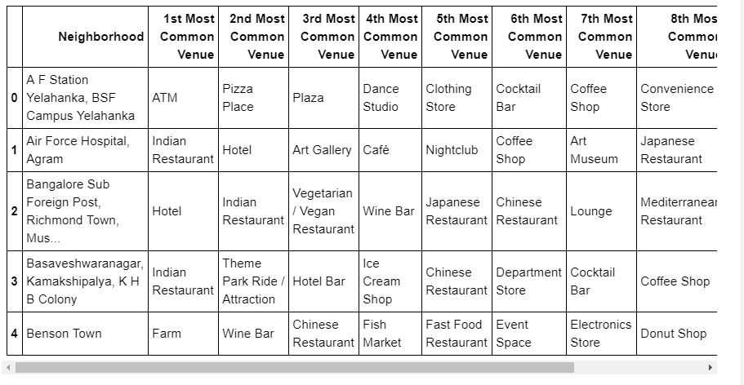
Results
In summary, 50 unique categories were returned by Foursquare, then I created a table which shows list of top 10 venue category for each neighbourhood:

Slide 12
Results…Contd.
We have some common venue categories in neighbourhoods. For that reason I used unsupervised learning K-means algorithm to cluster the neighbourhoods. K-Means algorithm is one of the most common cluster methods of unsupervised learning.

Slide 13
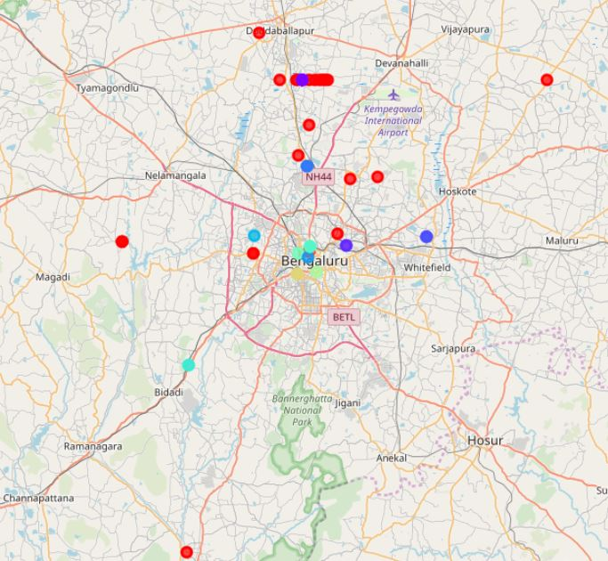
Results…Contd.
I ended the study by visualizing the data and clustering information on the Bengaluru map

Slide 14
Conclusion
People can decide based on their interest which neighbourhoods to live in or figure out major hubs using such information.
Investors can check near by venues and decide if it is ideal to start a business in that particular neighbourhood.
Further, the analysis can be extended to consider the average rent of properties and make accurate decisions.

Slide 15
Thank You

